Slide 1

Fear of Floods:
The Flood Health Vulnerability Index in San Francisco
By: Ben Liebkemann, Pan Lu, Brian Bordeaux, Max Xu

Slide 2
Driving Question
How vulnerable are various San Francisco regions to the health effects of floods and what factors make them vulnerable?
Notes:
How do define vulnerability ?

Slide 3
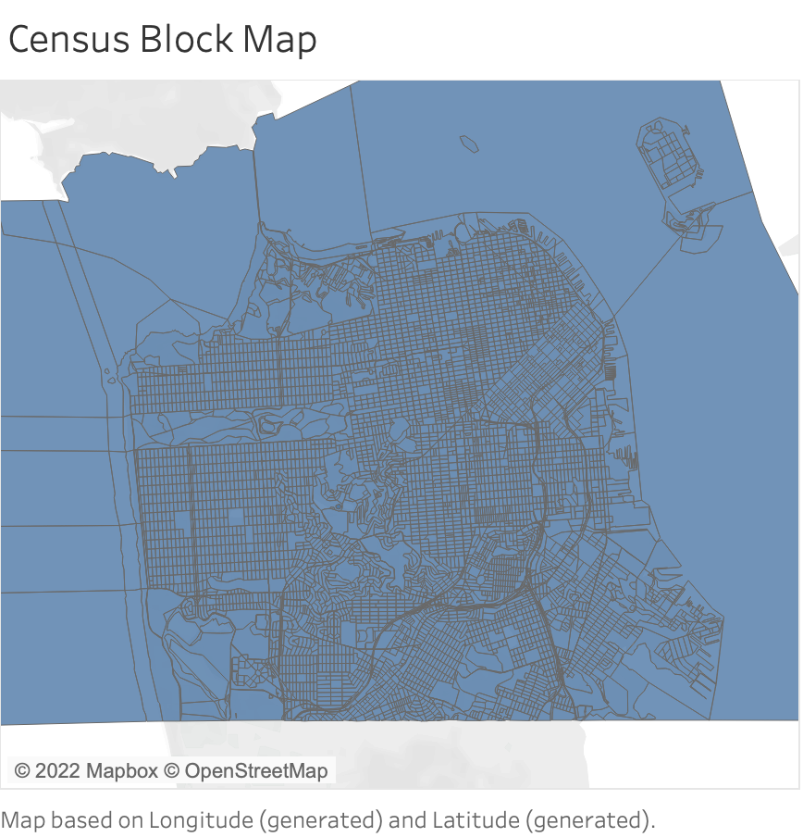
Our Data
Provided Dataset: San Francisco Flood Health Vulnerability | HealthData.gov
Information about various regions of San Francisco
Flood Health Vulnerability Index
“Relative vulnerability to the health impacts of flood inundation”
Supplemental Dataset: sfgov.org
Geographic information based on 2010 census blocks
Map Data

Slide 4
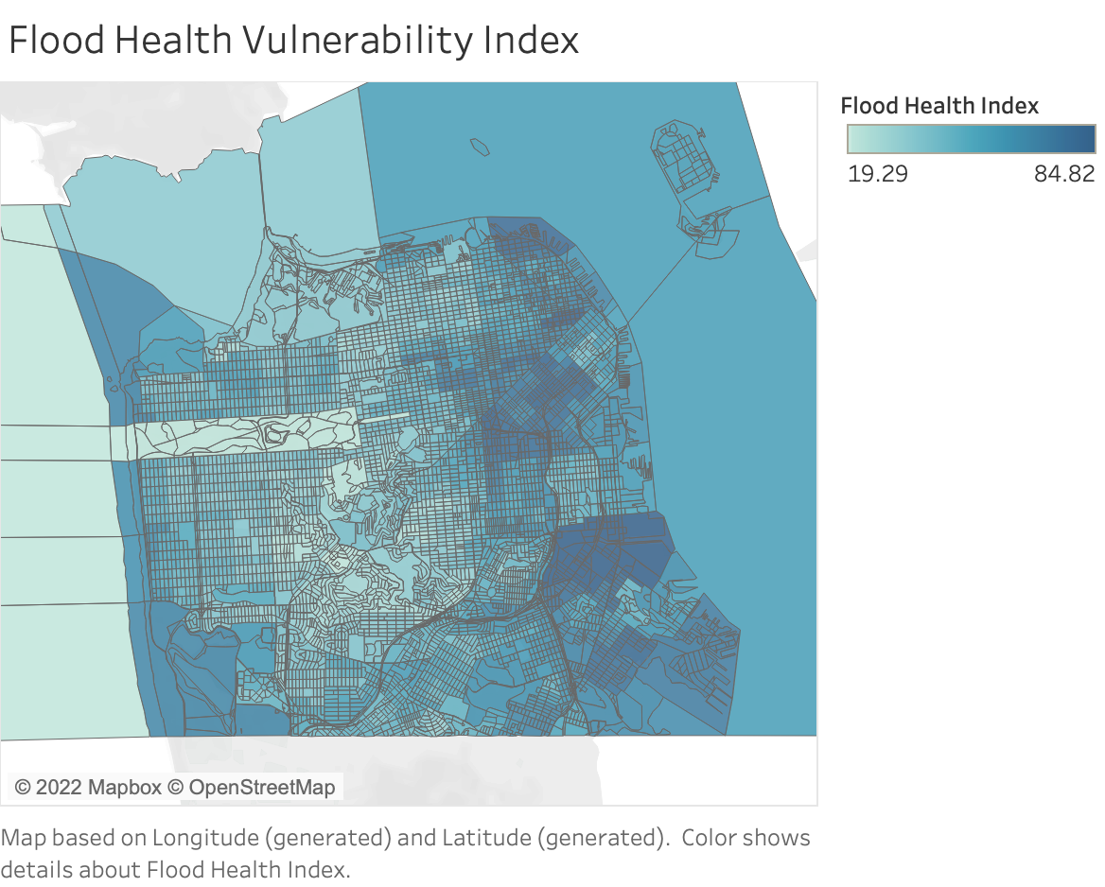
How Should We Model?
Goal
Mitigate health disparity
Data Cleaning (EDA)
Null values
Values > quintiles
Indicators Given: Flood Health Index Comp
Social and Demographic Vulnerability
Exposure Vulnerability
Health Vulnerability
Housing Vulnerability
Introduction of geographical Indicators
Longitude and latitude
Notes:
We hope that our model can be used to accurately point out human health vulnerability in different regions in the event of a flood so that resources can be allocated to the most needed area.
Then, we first did our data cleaning. We first dropped the columns with all null values. And we chose FloodHealthIndex counted in percentiles to be our response variable so that we can better understand the difference in vulnerability of different regions.
And predictors can be divided into four categories. Children,Elderly
However, the relationship of our data to locations seems vague. Thus, we decided to introduce longitudes and latitudes. (we had censusblock as a variable, found a dataset that contained long & lat and censusblock. We then connected

Slide 5
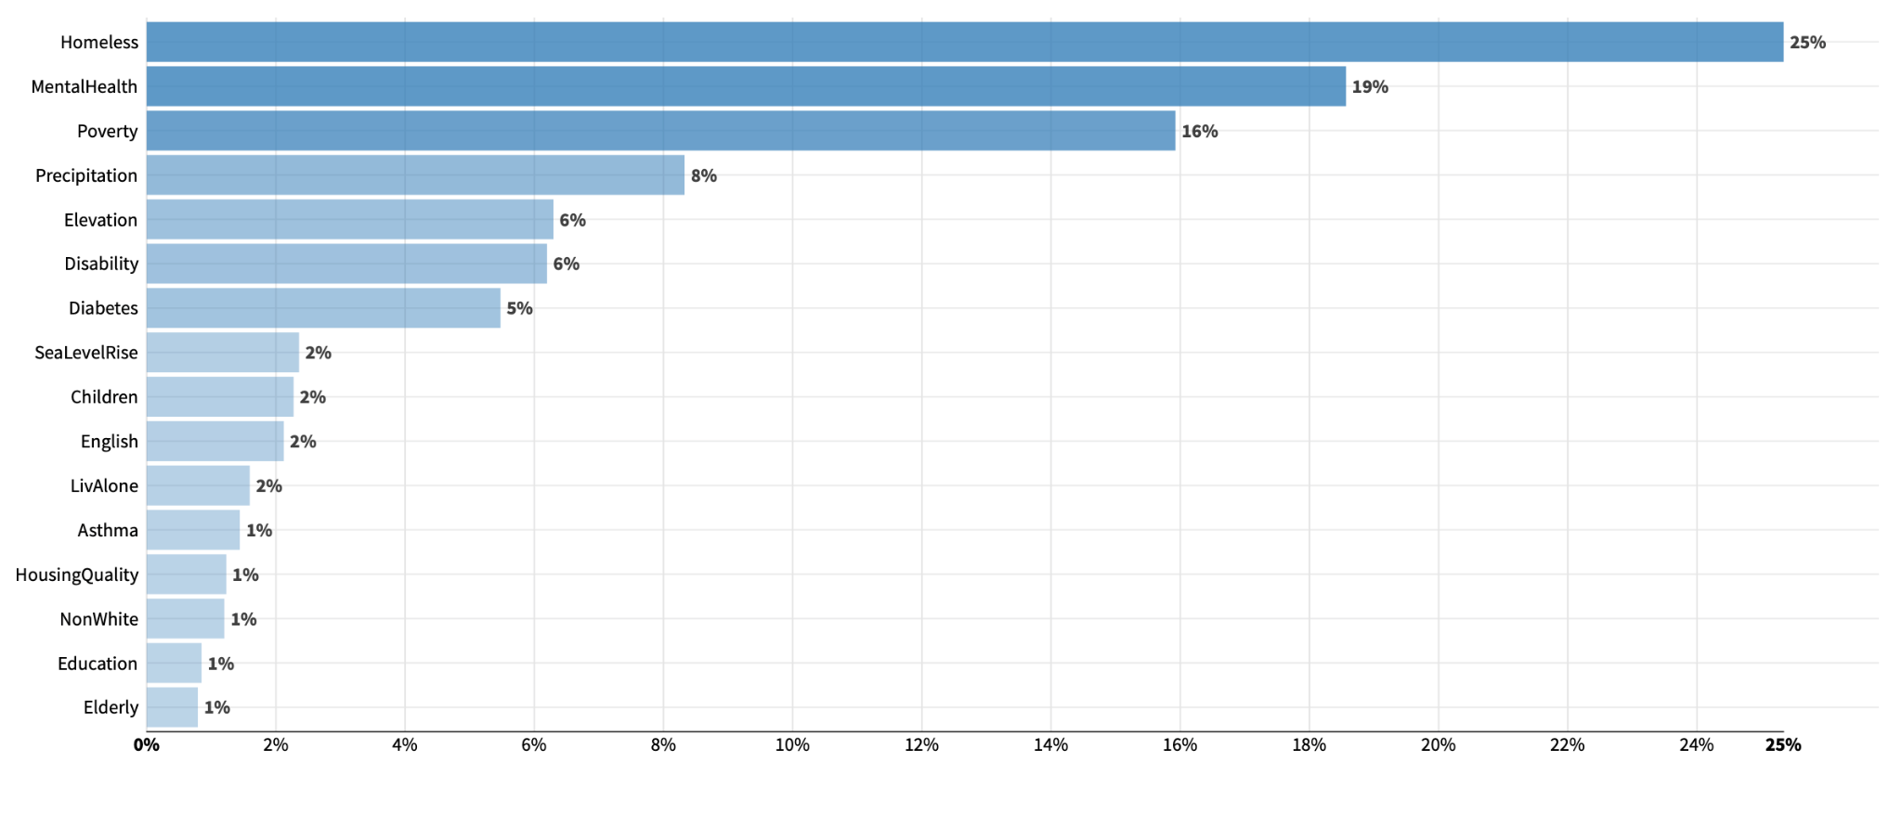
Flood Health Vulnerability Index Definition:
Notes:
This is a composition of the below listed factors which determine how much and how likely you will affected by a flood
This is how we ended up defining the flood health index based on after the processes

Slide 6
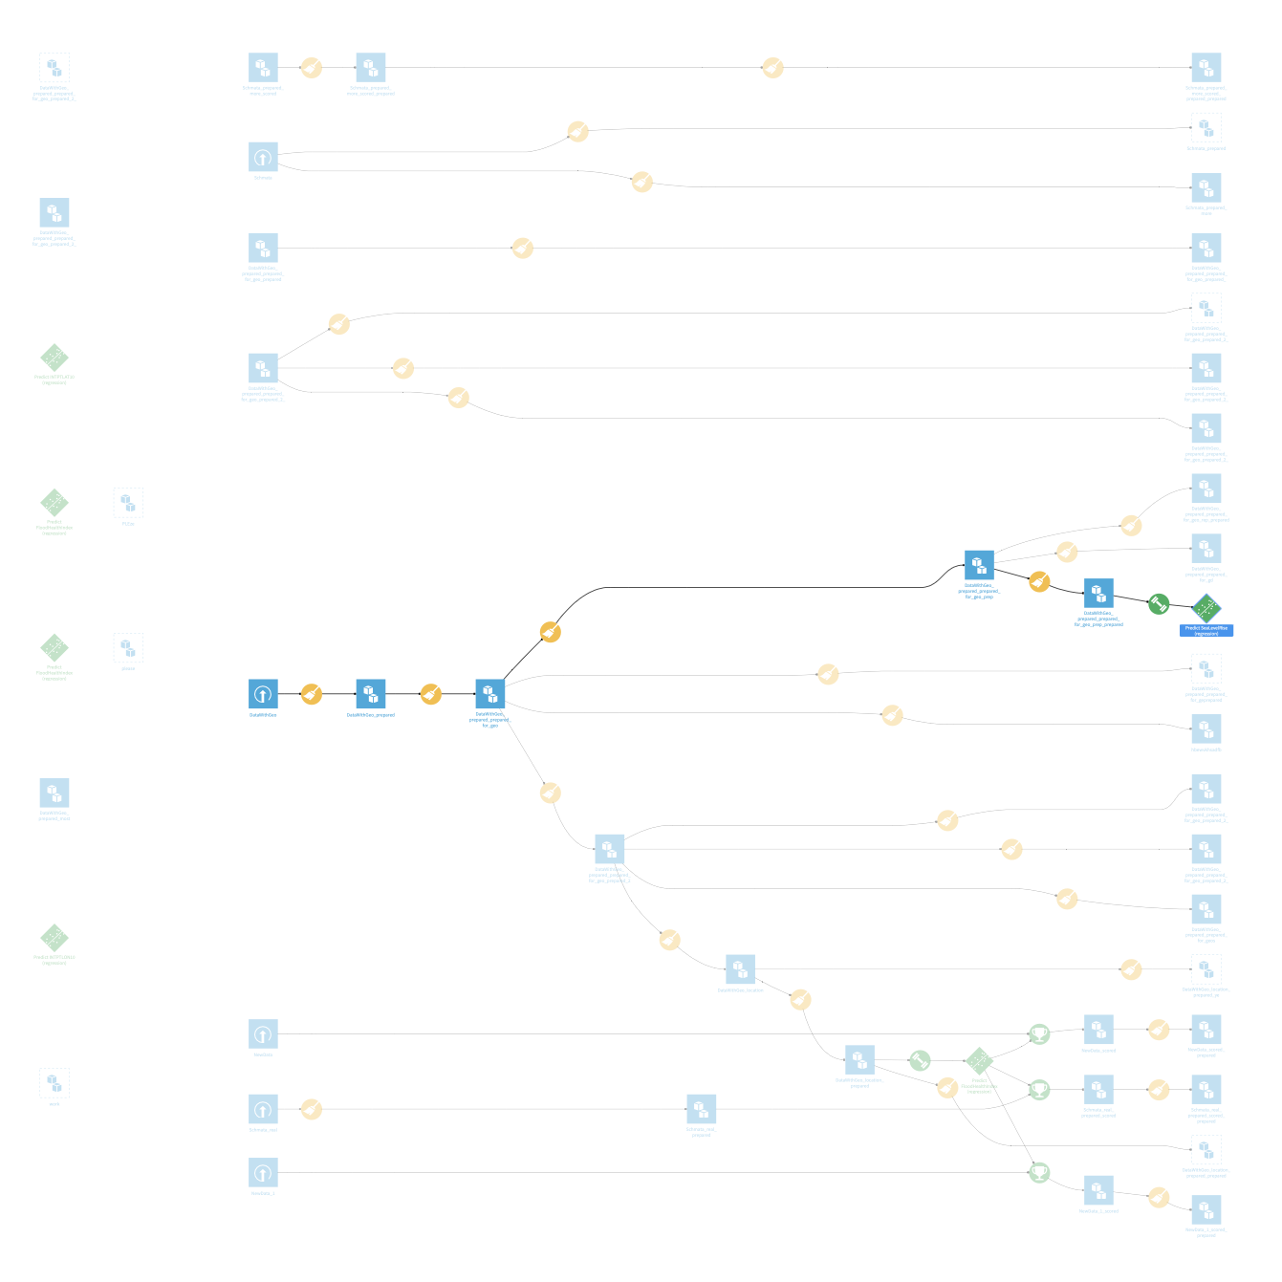
Building the Model
Dataiku
K-Nearest-Neighbor Model (KNN)
Modifying Data
Each branch is modifying the data in a different way
Visualization

Slide 7
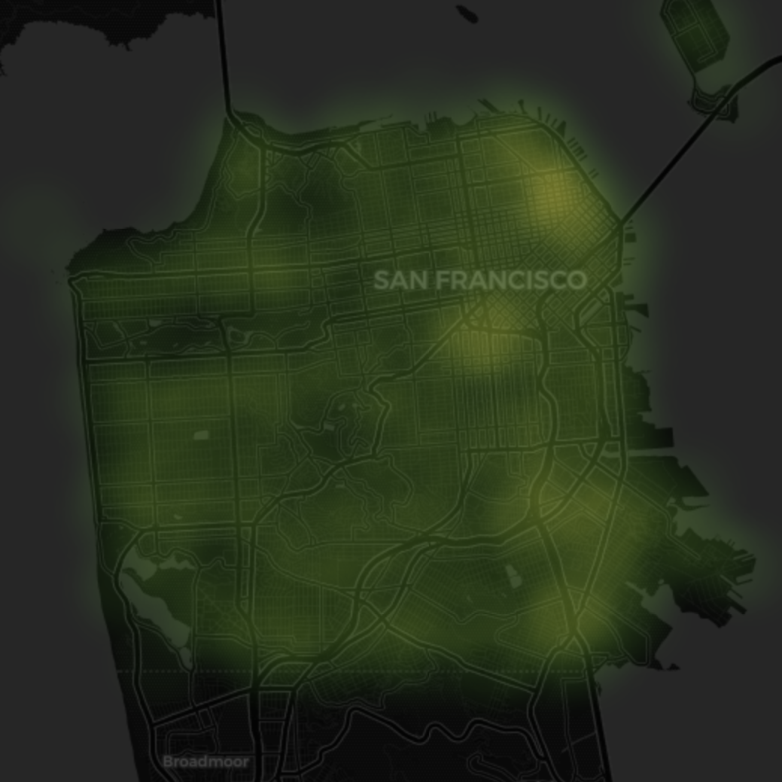
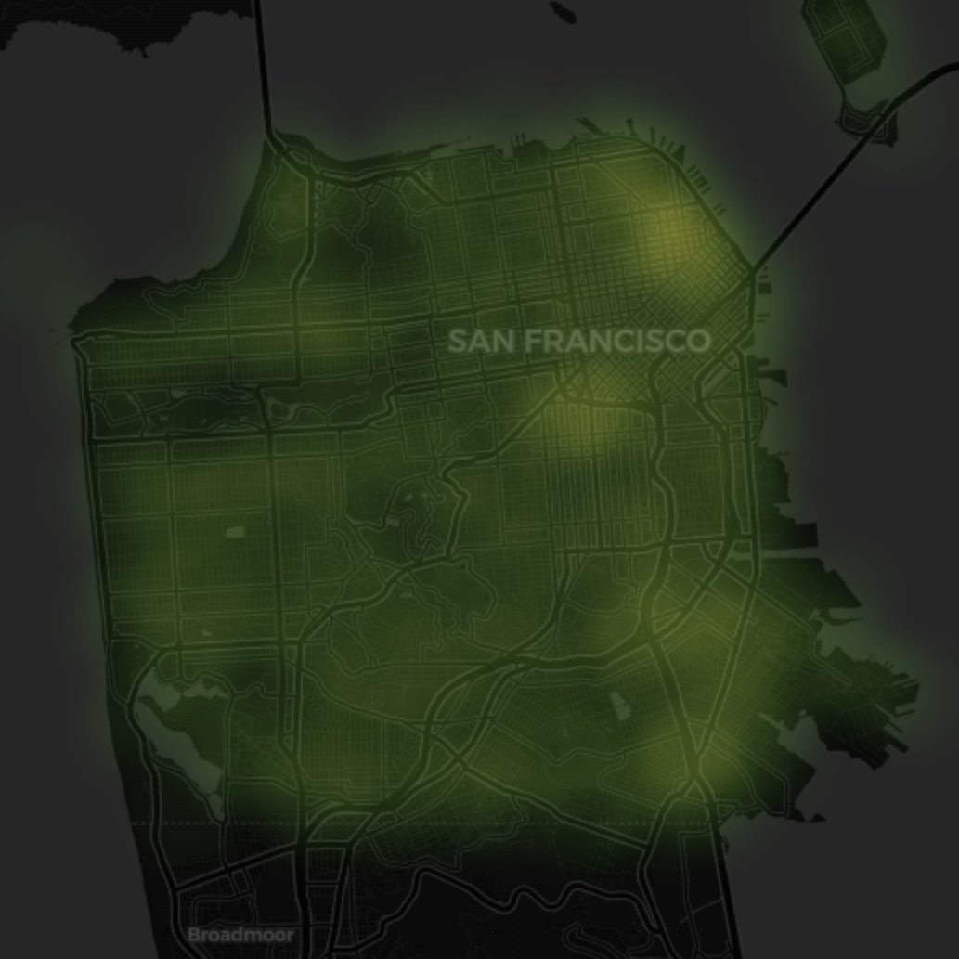
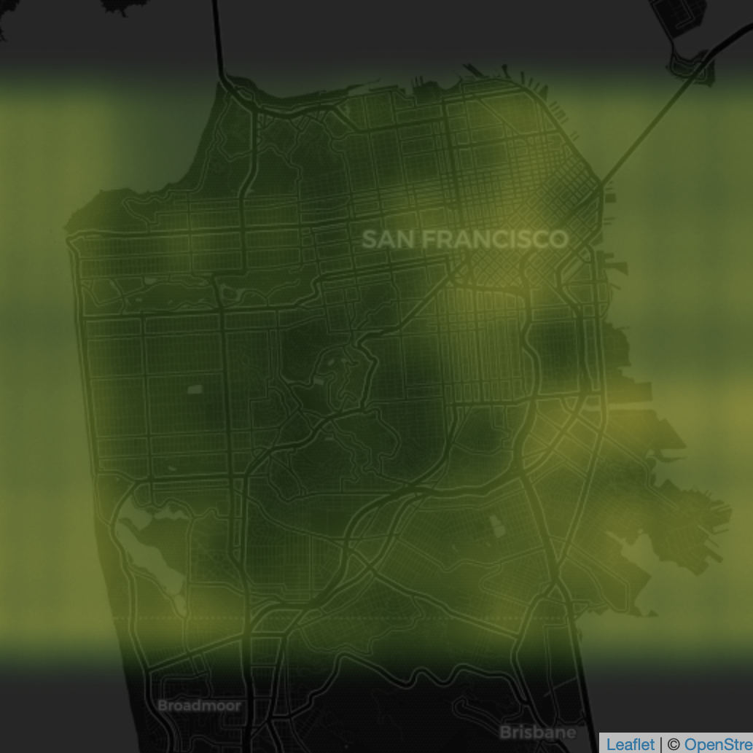
Our Model: Predicted vs. Actual
Predicted
(Census Geographic Data)
Predicted
(Custom Geographic Data)
Ground Truth
Accuracy = 0.931
Notes:
Fed in longitude and latitude and got out Flood Health Vulnerability Index Value

Slide 8
What Does This Mean?
Higher-risk areas concentrated near water
Pockets of higher-risk areas
Question: Why these areas specifically?

Slide 9
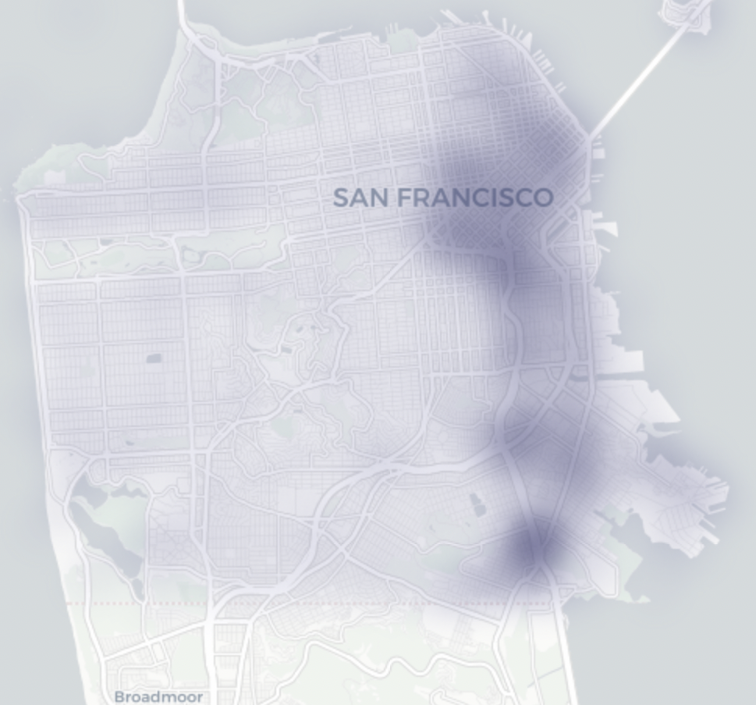
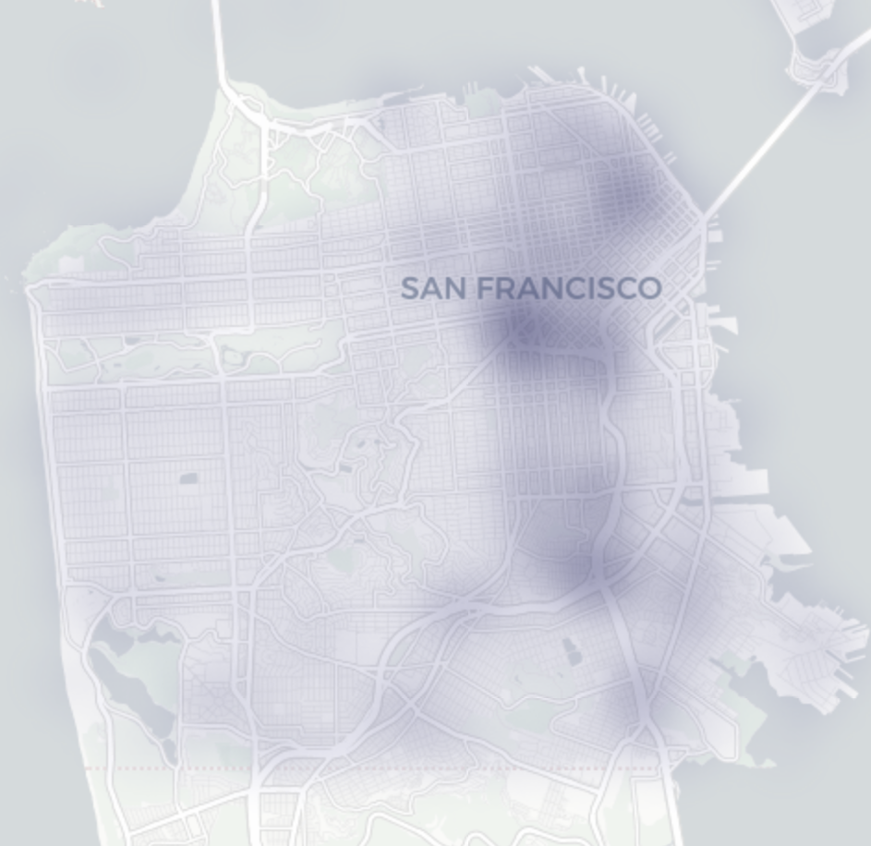
Who Lives in These Flood Affected Areas?
Flood Health Index
Homelessness
Mental Health

Slide 10
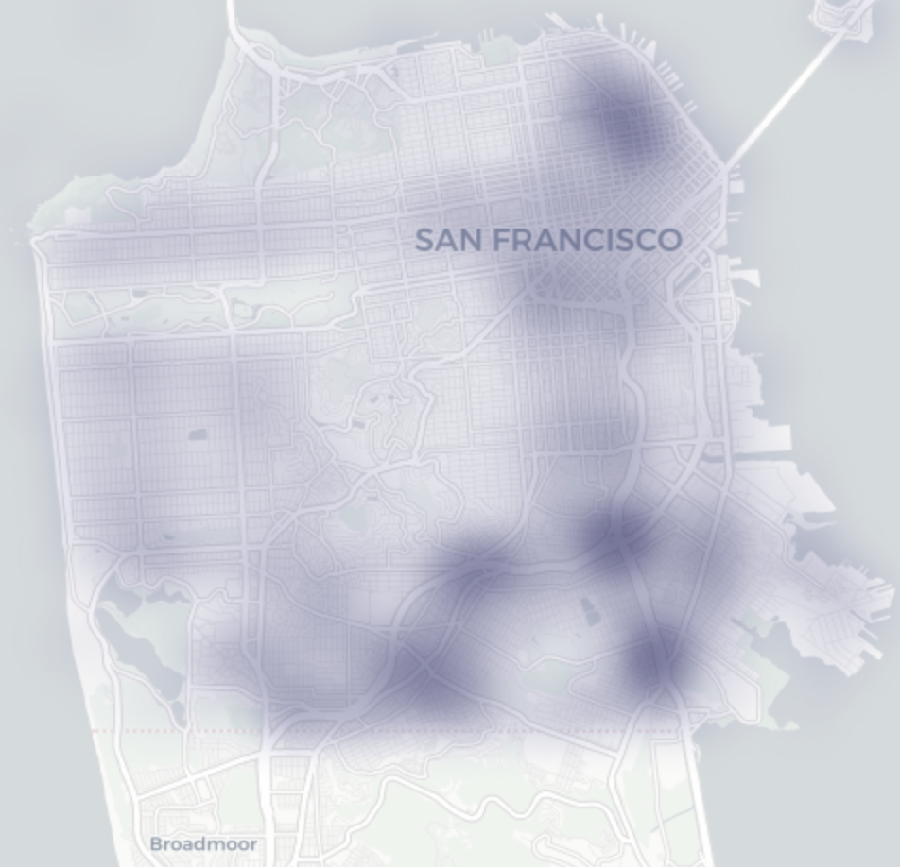
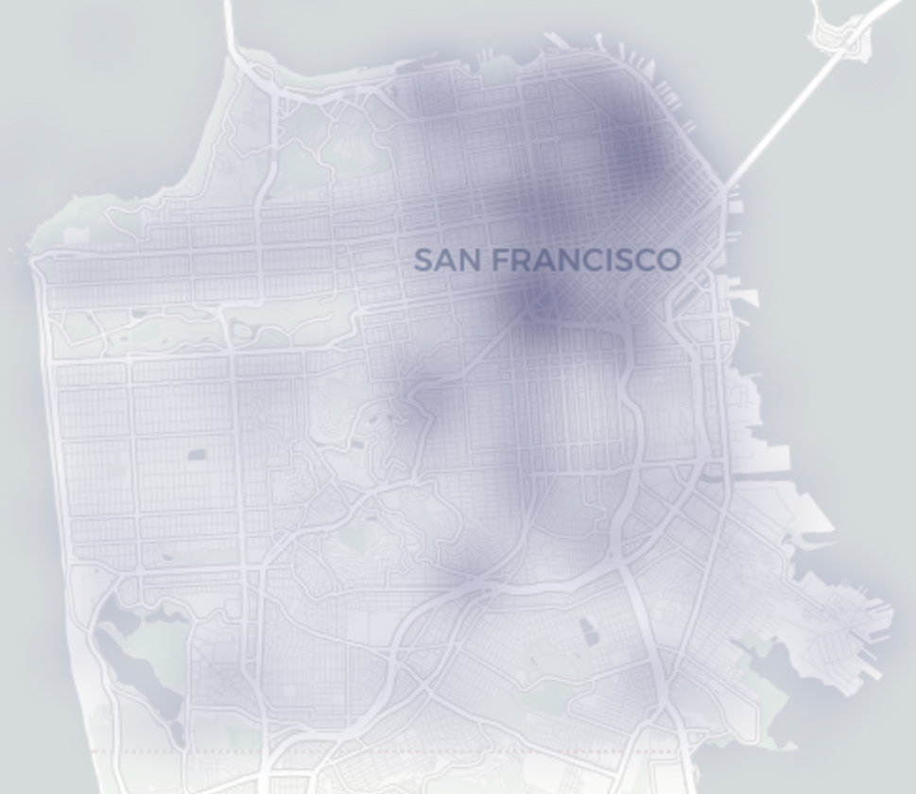
Who Lives in These Flood Affected Areas? contd.
Flood Health Index
Non-White
Living Alone

Slide 11
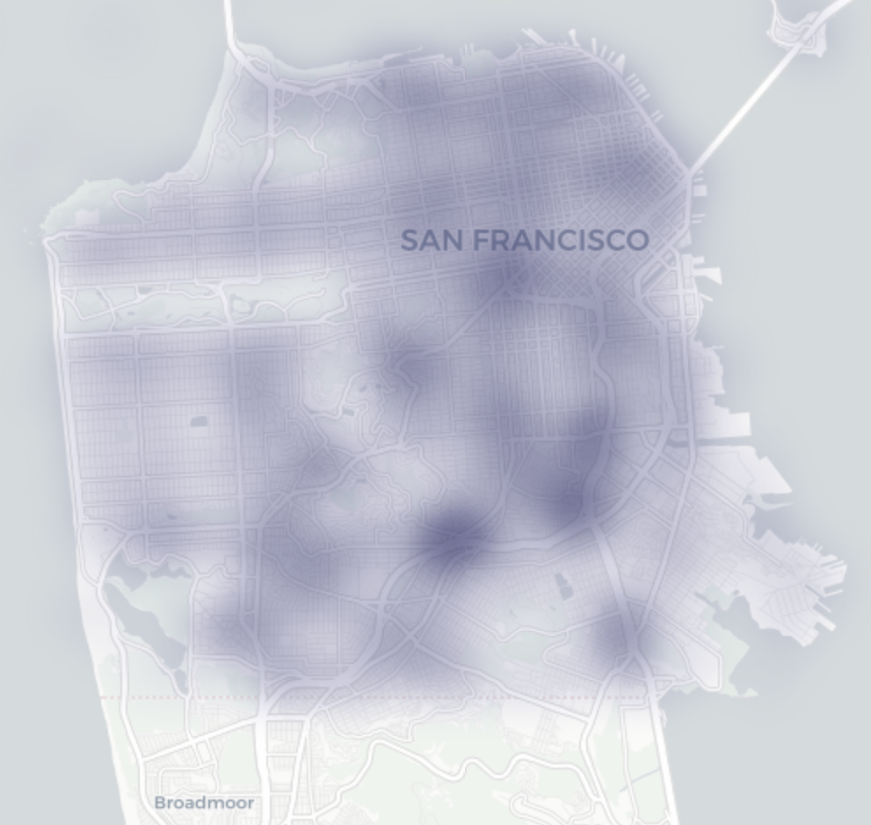
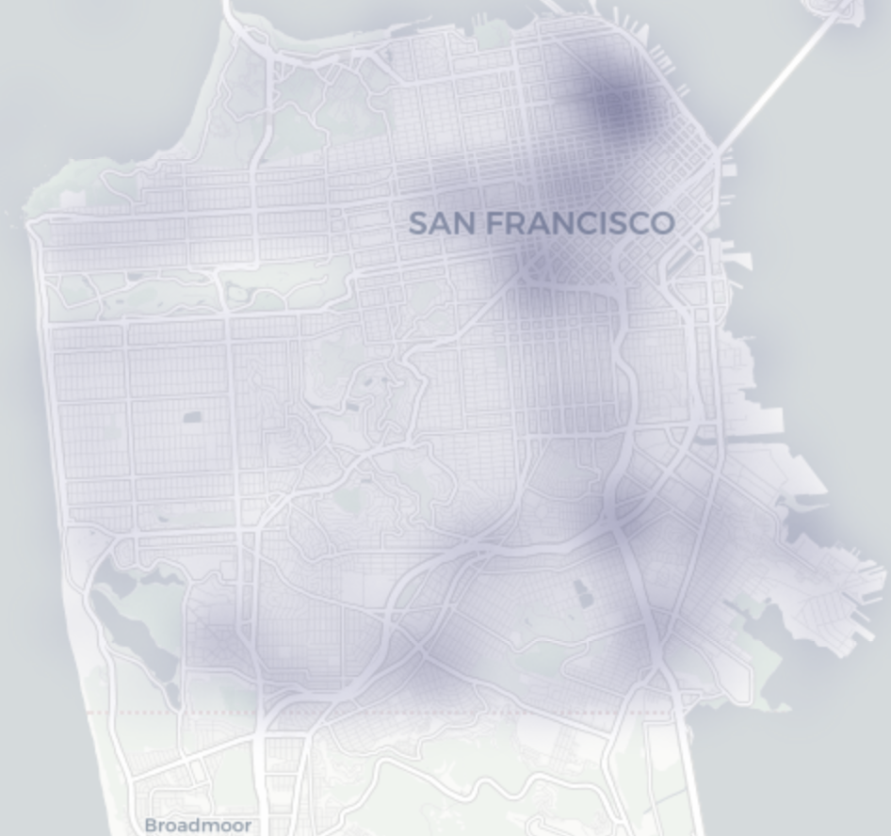
Who Lives in These Flood Affected Areas? contd.
Flood Health Index
Education
Poverty

Slide 12
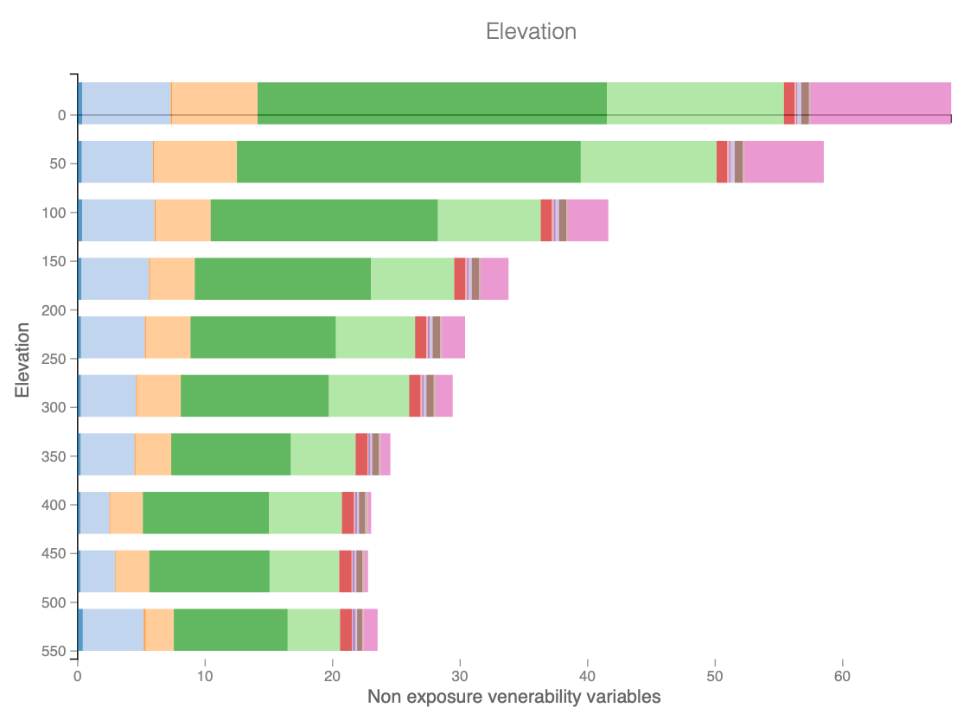
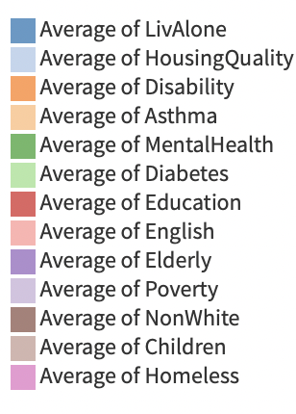
Demographics - Who Has the High Ground

Slide 13
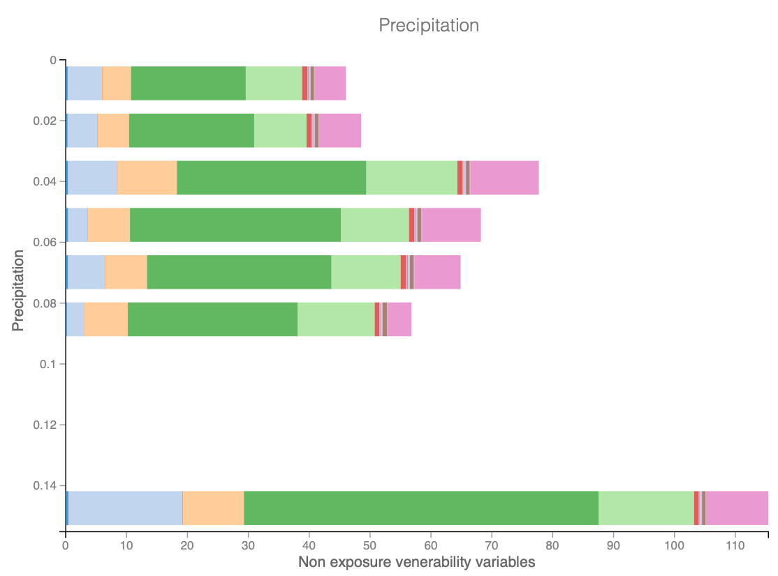
Demographics - Who Has the High Ground contd.

Slide 14
Takeaways
Flood Health Index
Socio-Economic Issues
The highest-risk areas also have high rates of homelessness, poverty, mental health issues, etc.
Class Issues?
Solutions
Education
Resource Allocation
Software Used: Dataiku, Tableau
Notes:
Increase funding of these areas to help combat the effects of flood
People who live in high elevation are privileged, poor people can’t afford places that avoid the floods. Physical health of poor people are put at risk because they are poor.
Help government and organizations make more informed logistic decisions should a flood happen.
Direct the focus of Municipal and caregiving resources onto areas of need. Be it preventive health care initiatives, or shelter facilities.
The flood vulnerability index can be used to discuss climate change impacts on public health and as a starting point for planning interventions, education, and outreach, and evaluating the success of these efforts.

